Slide 1
Promotional Pack
ESC Marketing Team

Slide 2
1) What ‘ESC Mentoring’ is

Slide 3
ESC Mentoring’s key features
ESC Mentoring in a nutshell
An easy-to-use digital mentoring platform, giving one-to-one access to mentors and mentees from across the world.
A nurturing and supportive programme, around the concept of members supporting each other.
An intuitive interface gathering all necessary support and resources to get the best out of a year-long mentoring programme experience.
A full control over the mentorship experience.

Slide 4


Who can have access ?
ESC Mentoring is one of the multiple benefits exclusively available to paying members only.
Mentees
Mentors
→ Any ESC Professional Member or Silver/Gold Member of an ESC Association can sign up as a mentee, regardless of age or training status.
→ To become a mentor, you need to be an ESC Professional or Silver/Gold Member of an ESC Association. We especially encourage Fellows and Emeritus Fellows to join as mentors. A mentor can also be a mentee if desired.

Slide 5
2) How the platform works

Slide 6
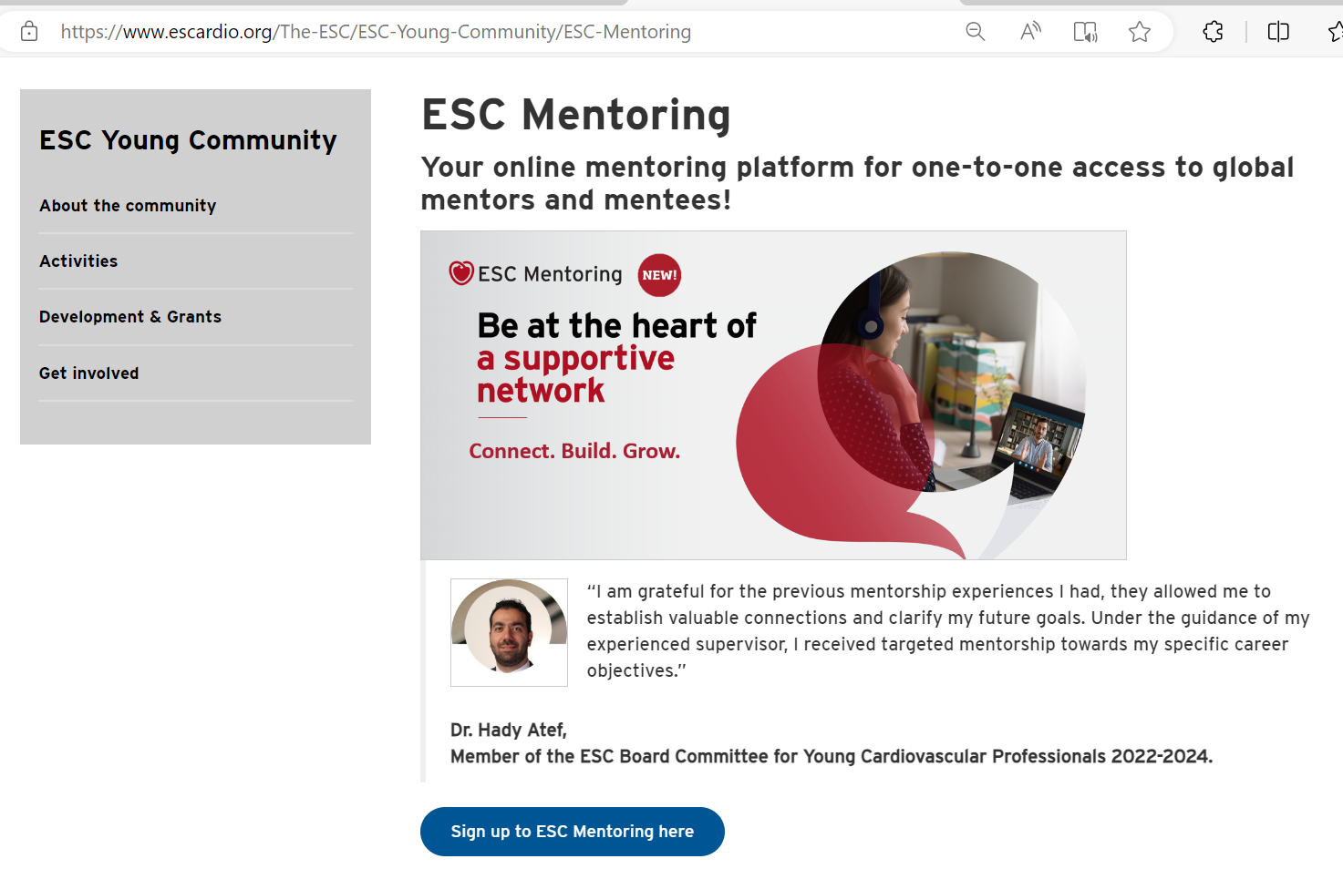
What is ESC Mentoring’s user journey ?
Dedicated webpage on Escardio.org
ESC Mentoring (escardio.org)
Sign up button to access
‘ESC Mentoring’

Slide 7
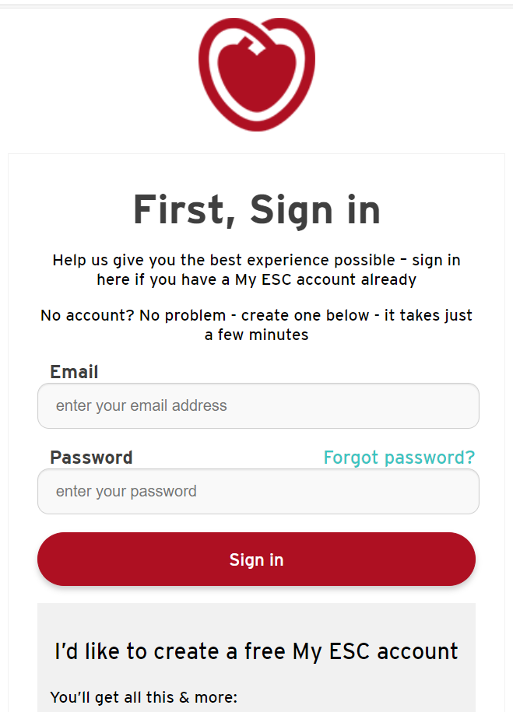
What is ESC Mentoring’s user journey ?
Single Sign-On (SSO) system
Users will be invited to connect to their My ESC Account or to create one

Slide 8
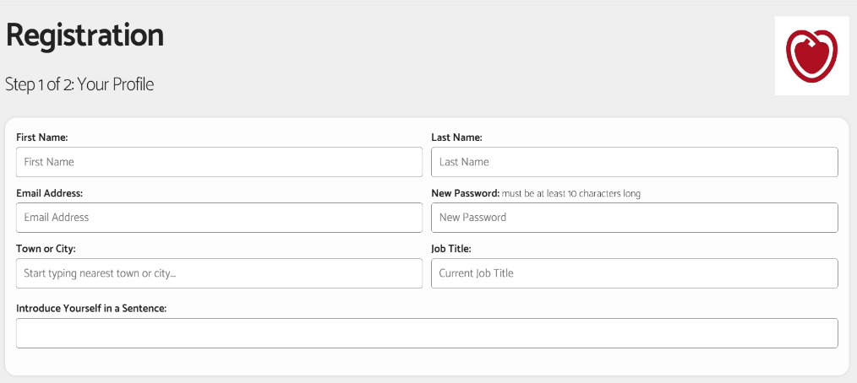
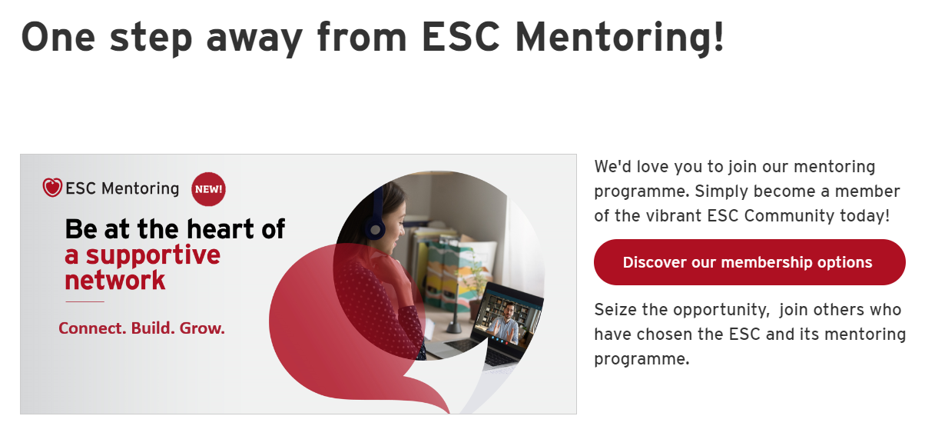
What is ESC Mentoring’s user journey ?
ESC Mentoring access
If the user is already an ESC/Assoc. paying member – Access allowed
If the user isn’t yet an ESC/Assoc. paying member – Access denied

Slide 9
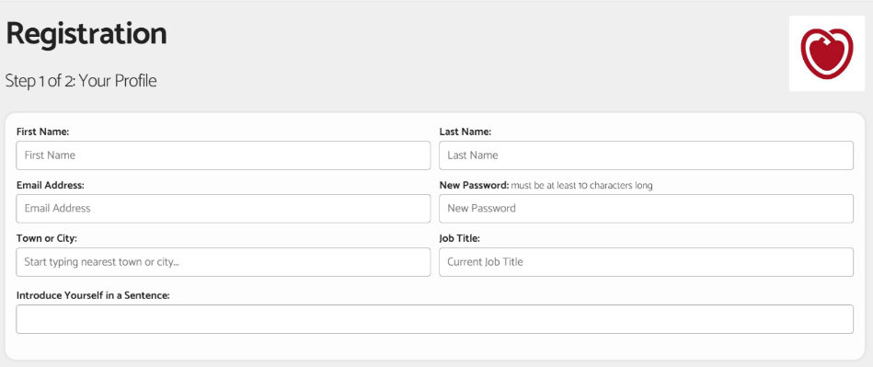
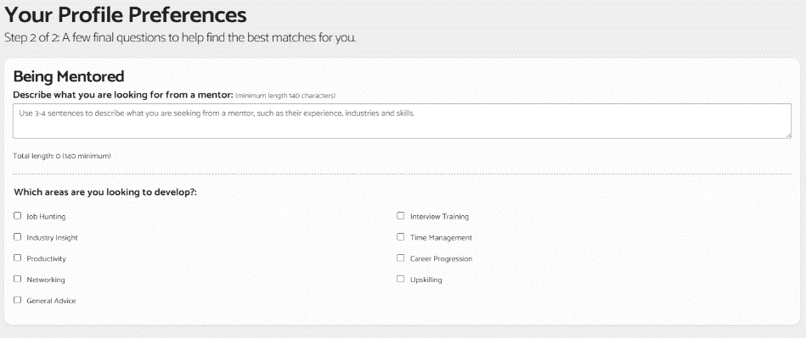
What is ESC Mentoring’s user journey ?
ESC Mentoring – Profile creation
Step 1: General information
Step 2: Mentoring preferences

Slide 10
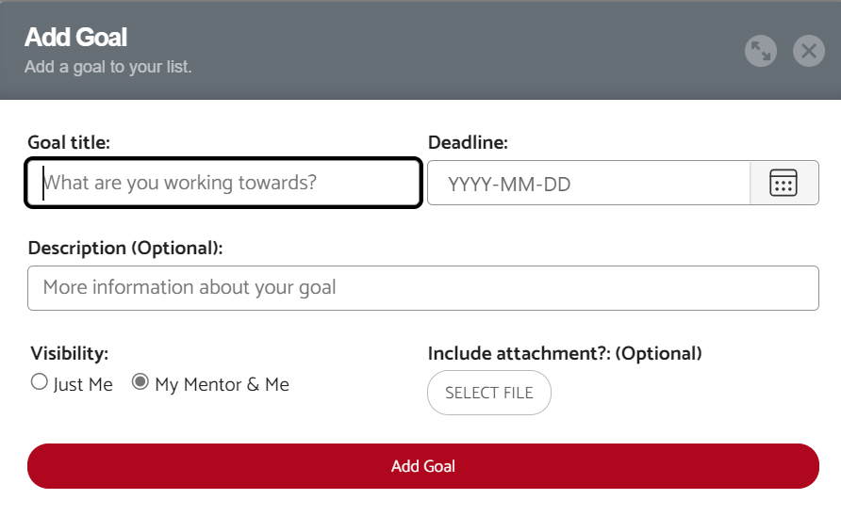
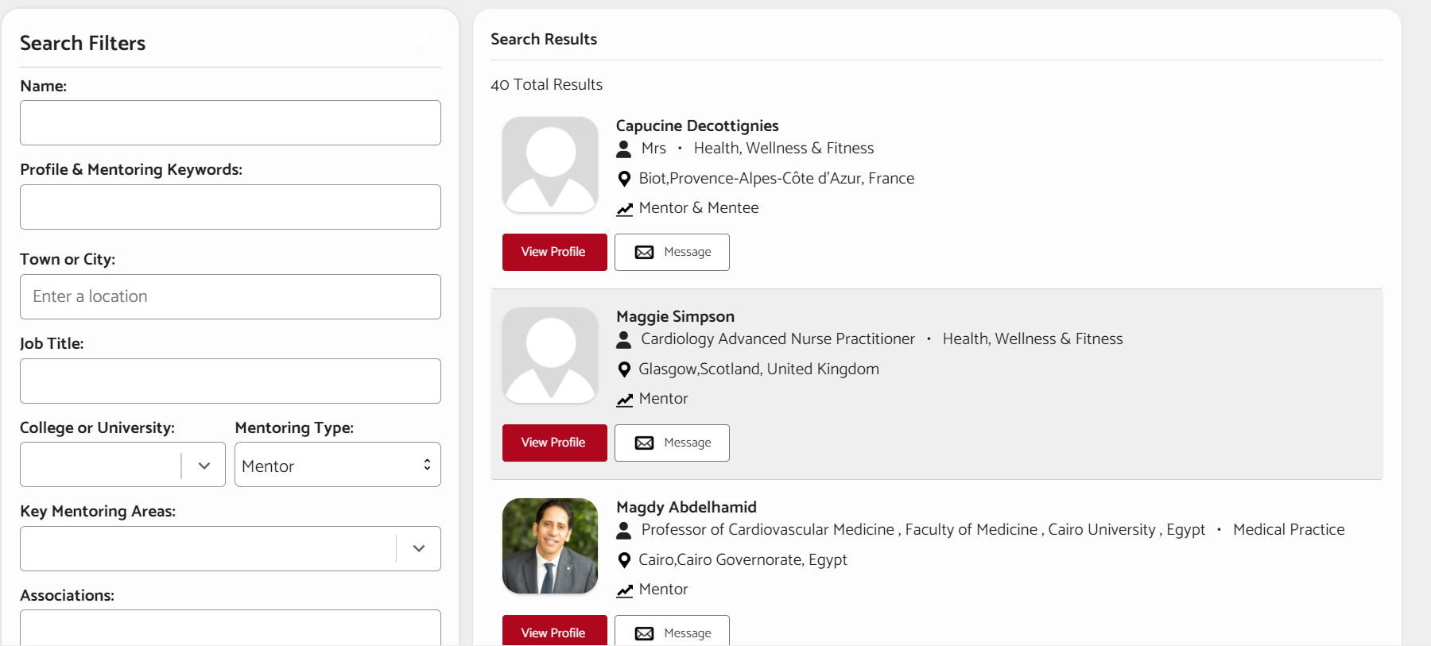
What is ESC Mentoring’s user journey ?
Mentee/Mentor connection
Step 1: Set clear objectives
Step 2: It’s on the mentee to request their ideal match as a mentor
Search filters to ease the matching process
Option to filter by ESC Associations, WGs & Councils

Slide 11
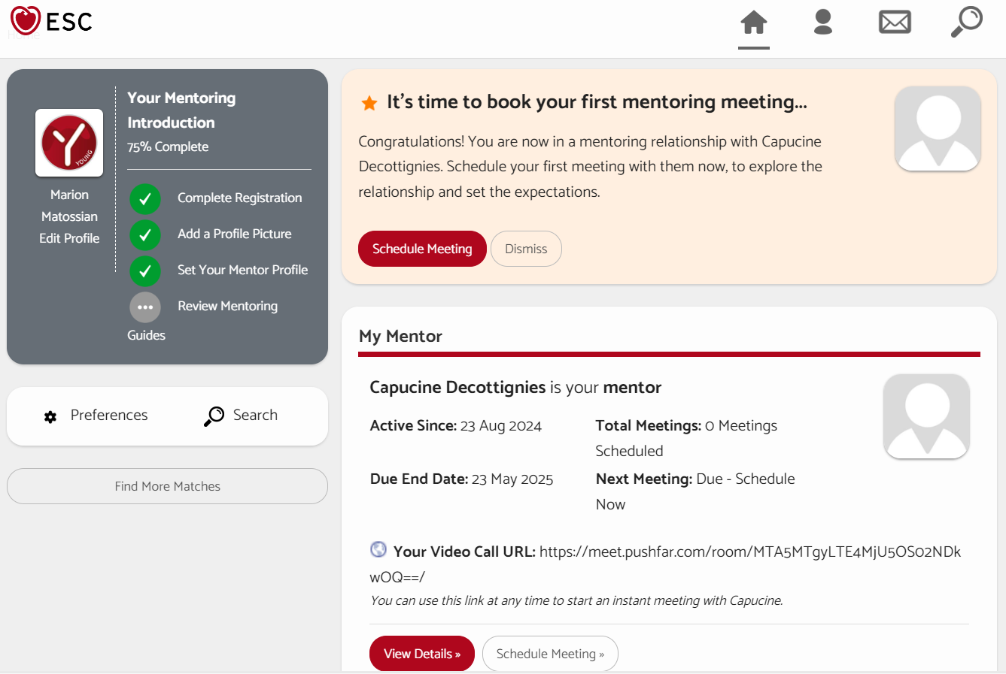
What is ESC Mentoring’s user journey ?
Mentee/Mentor connection
Step 3: First meeting set up

